Slide 1
HACKATHON -2021
TECH ESCAPADES
NAZNEEN SHAIK
FAIZ AHMED SIDDIQH K
SWAPNADIP HALDAR
GOURAB DUTTA
AUTOMATION FRAMEWORK -BOOKMYSHOW

Slide 2
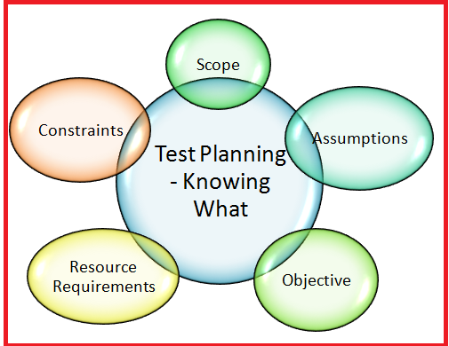
OBJECTIVES AND GOALS
PROBLEM STATEMENT
Display all the sports activities available in your city for coming weekend using Bookmyshow.com
Display all the languages of movies premiered in your city
Sign In using Google with Invalid credentials and capture Error message
To go through the basic flow and functionalities of Bookmyshow website and understand its working.
To prepare a test suite and test plan for the above requirements and test manually.
To Set Up Test Environment and Create a Automation Framework to test the manual testcases .
To implement best practices and create a Hybrid Framework using Apache POI library, POM, Maven , Jenkins, GIT, Fetching locators from XML etc..
To trigger build from Jenkins or from local machine and check the feasibility of the code written and check for failures.
To write clean code with comments and clean syntax for better readability and maintainence of the framework
To create a robust framework and carry out regression tests often to check build failures .
2

Slide 3

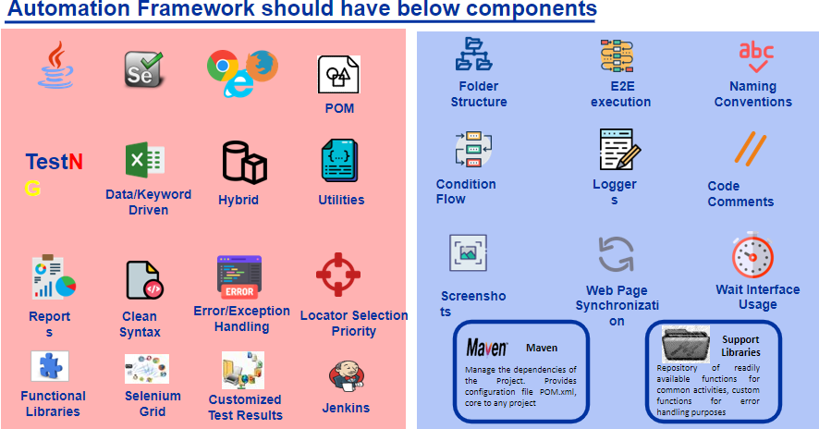
AUTOMATION FRAMEWORK KEY COMPONENTS
We have create a maven and downloaded the dependencies from pom.xml.
We have implemented the framework for Chrome and Firefox browsers.
Created a separate core package with all the base utilities .
Implementing the extent reporting with effective logging and capturing screenshots using external library.
Used DataDriven technique to fetch testdata and write results to excel file using Apache POI
Use the implicit and wait functions for the required steps.It is a dynamic framework and completely free from hard-code.
Creating a smoke and regression suite and triggering maven build from terminal for a particular profile.
Creating a job/build on Jenkins , configuring the project and triggering builds.
Unique locators of each module are located , mapped & fetched from a separate xml file.
POM[Page object Model] is implemented for code reusability and readability with clean syntax and Naming Conventions.
3

Slide 4
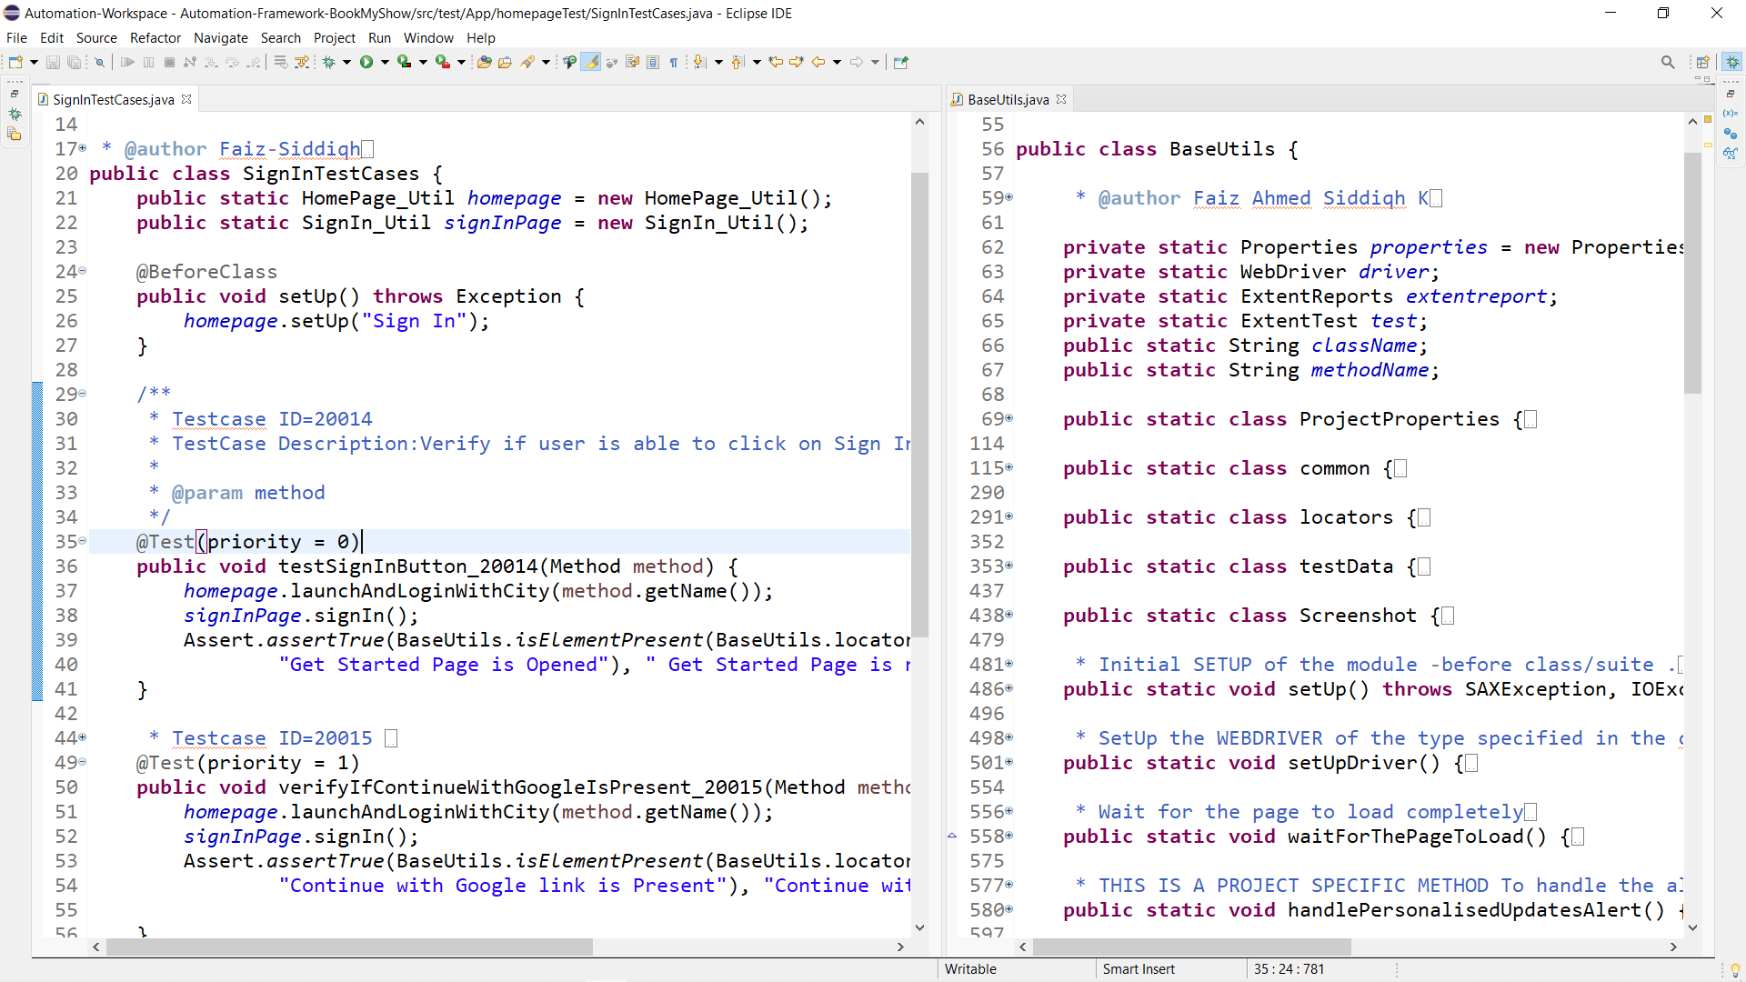
A VIEW OF CODE ON ECLIPSE

Slide 5
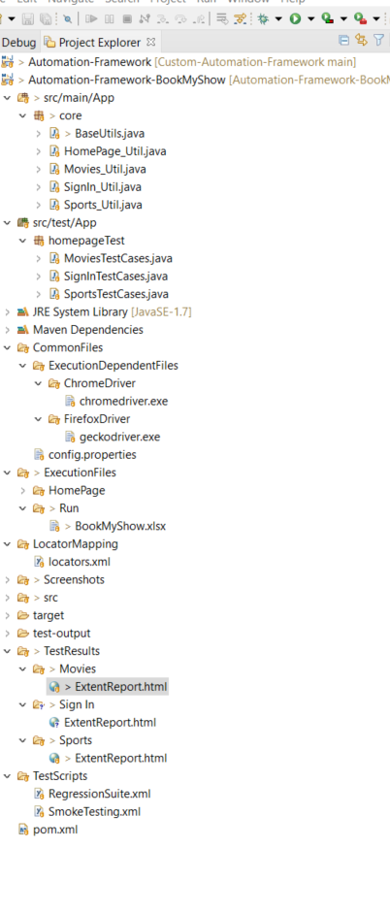
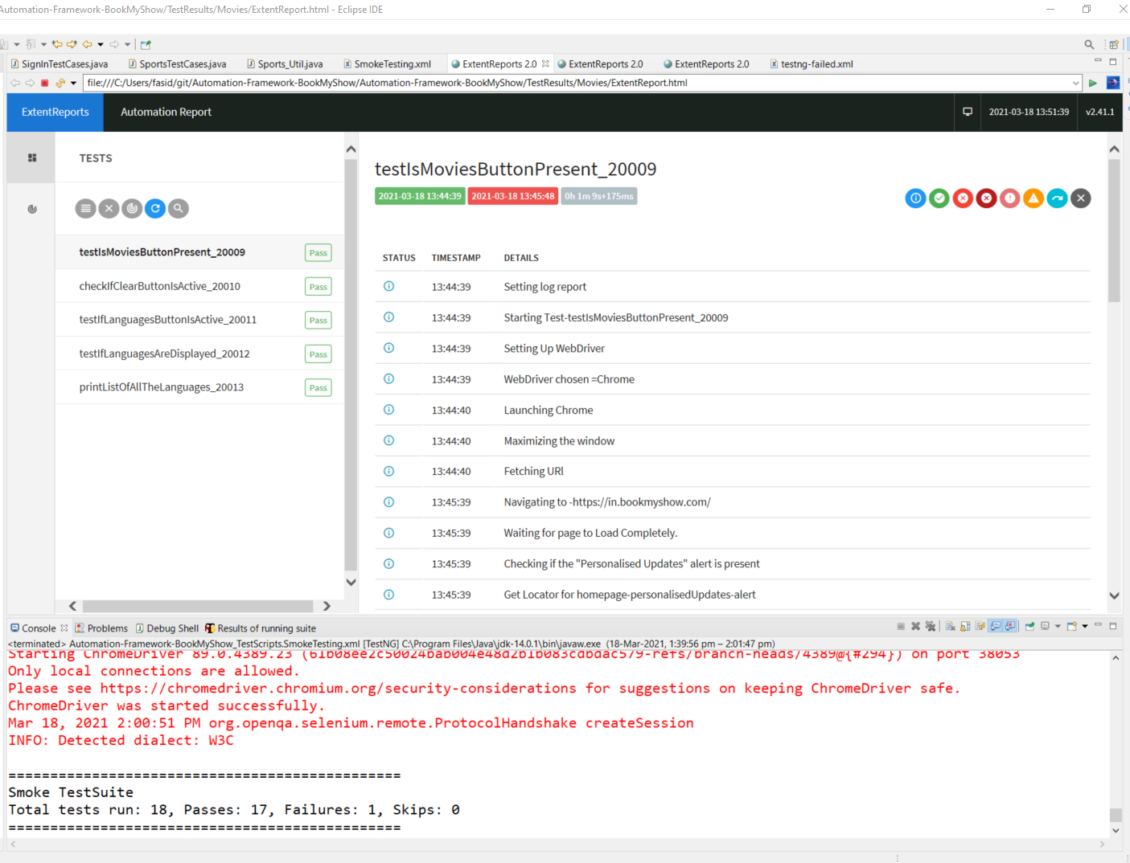
FOLDER STRUCTURE
EXTENT REPORT
4

Slide 6
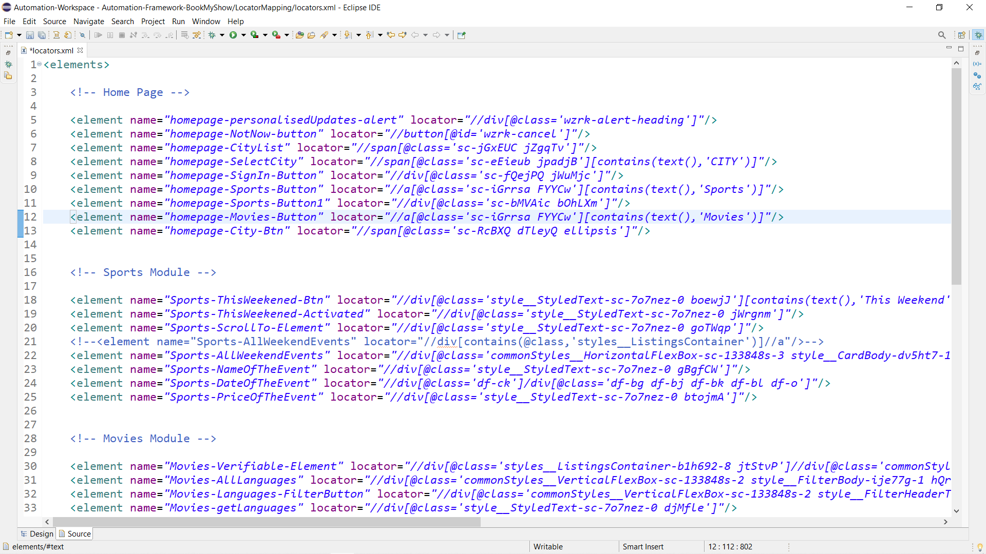
LOCATORS MAPPING

Slide 7
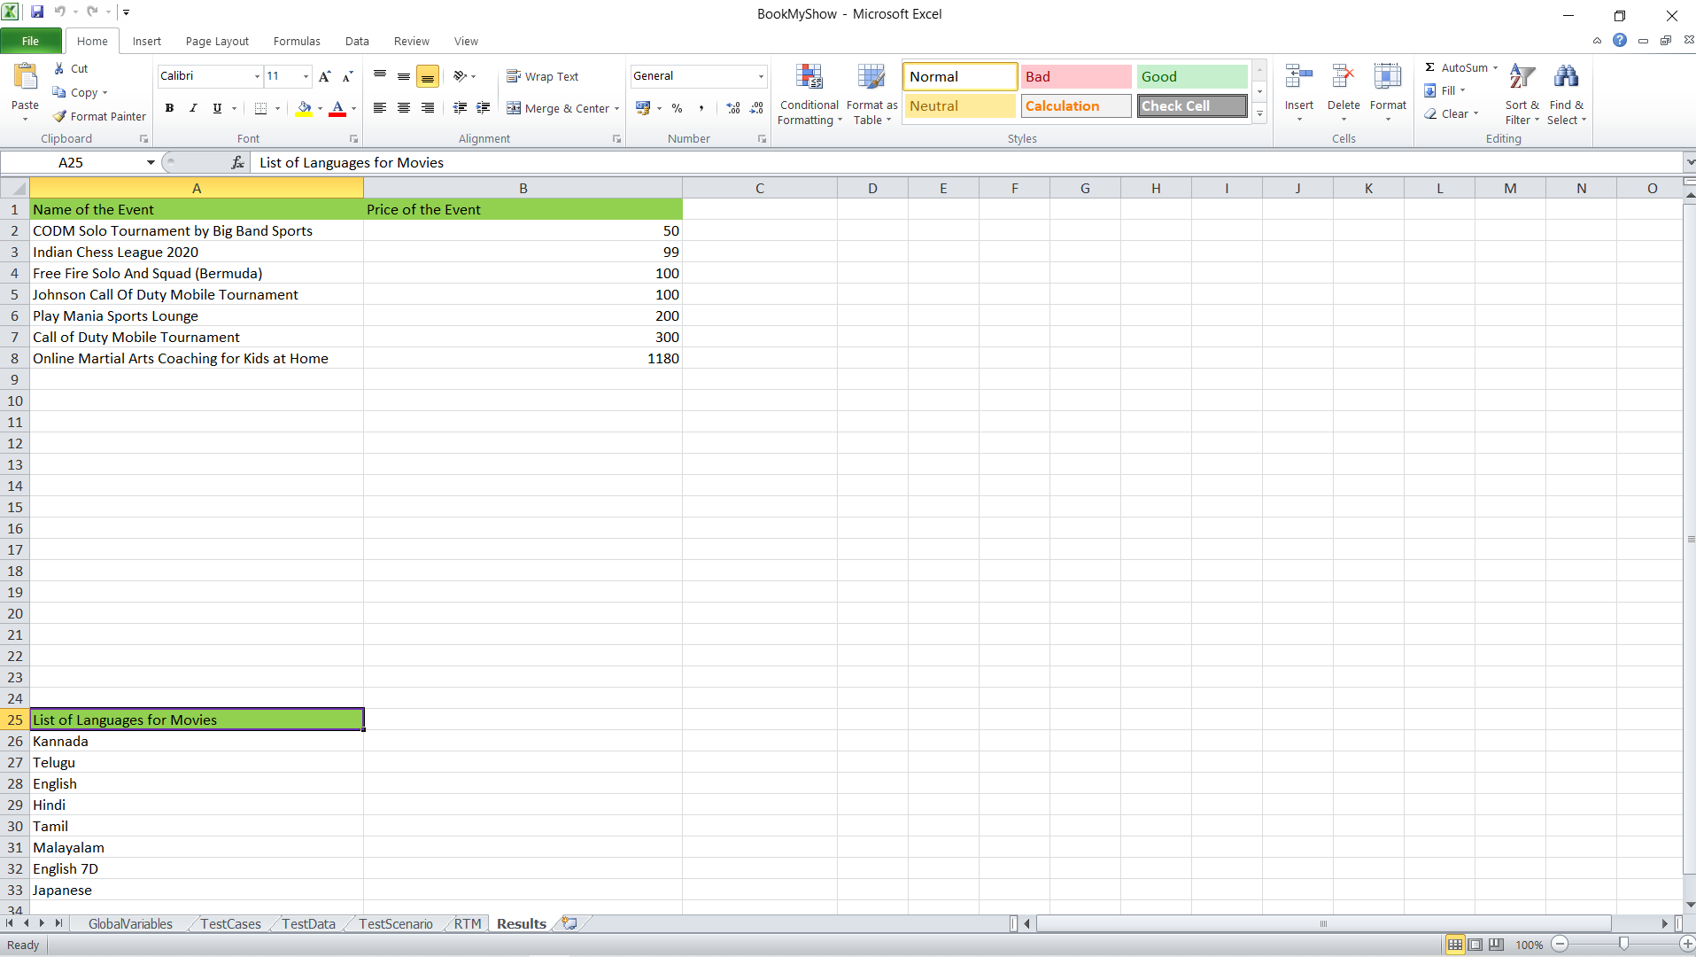
TEST RESULT

Slide 8
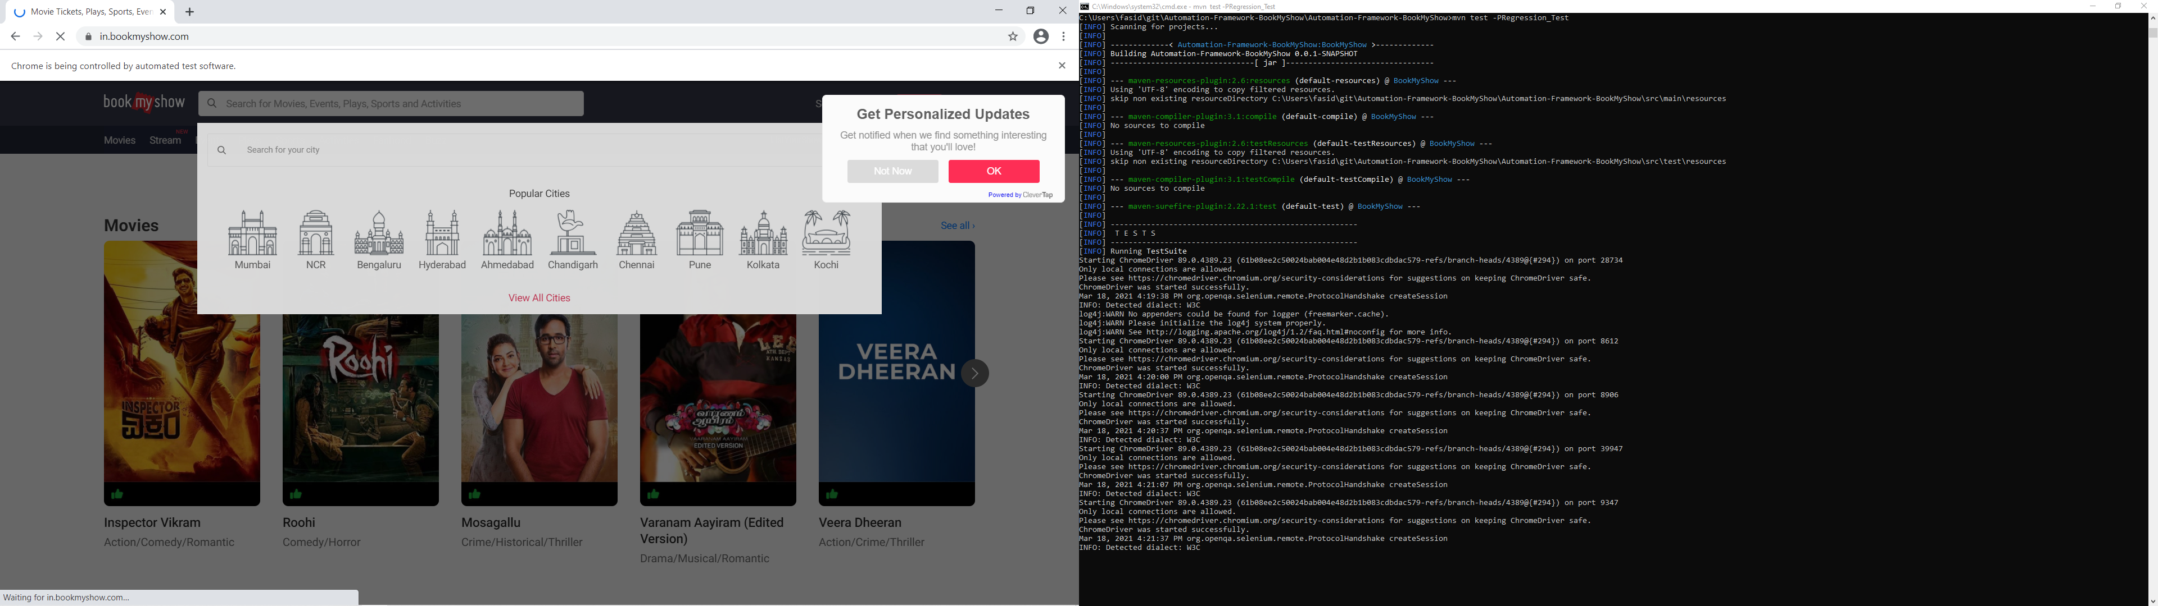
RUNNING TESTS THROUGH MAVEN
6

Slide 9
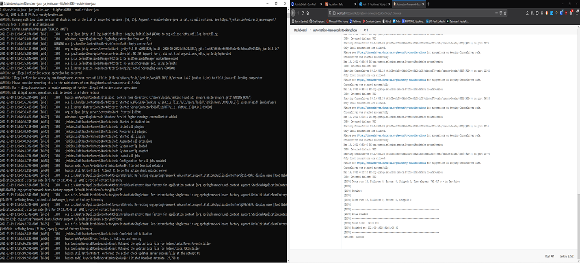
TRIGGERING BUILD ON JENKINS
7

Slide 10
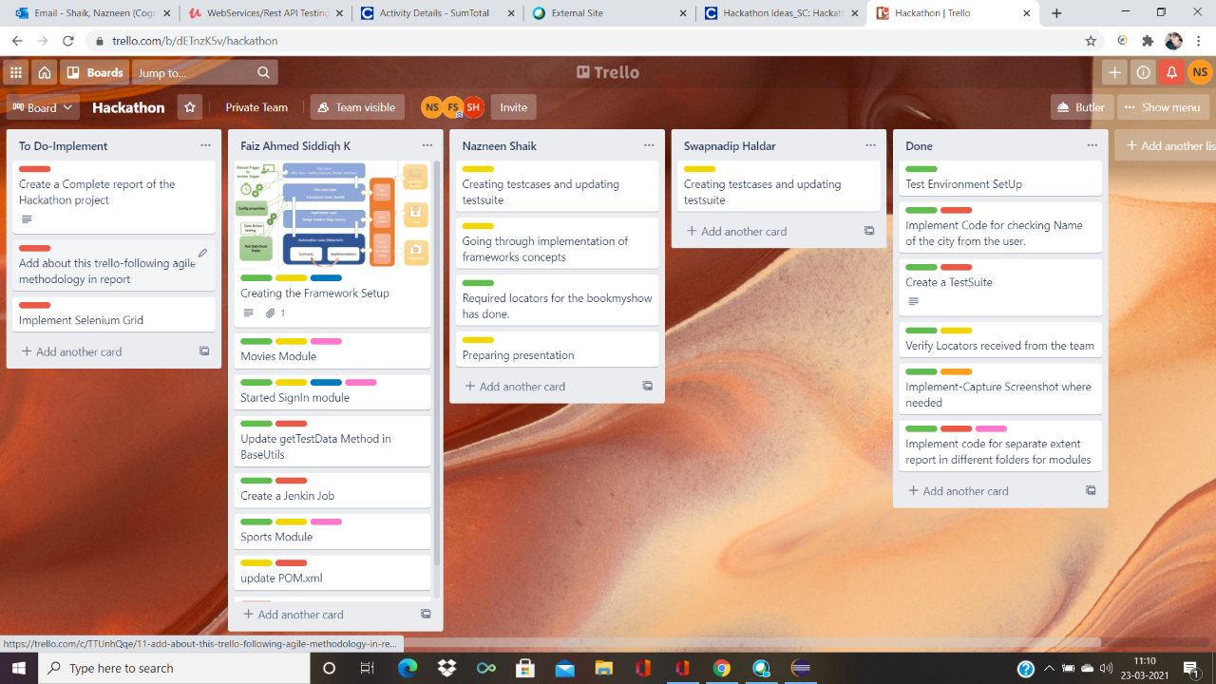
TEAM MANAGEMENT
We tried to follow agile methodology by defining and dividing tasks among the teams .We had daily standup call at 11 and used Trello for project management .This helped us in
Setting of objectives and timelines .
Division of modules-Dividing the project /deliverables into small tasks.
Effective communication –This helped in preventing conflicts as each member was aware what his teammates are doing & paved way for disscussion and helping each other whenever necessary.
5

Slide 11
CHALLENGES
Learning and installing softwares needed.
Understanding the workflow and framework of the entire process.
Finding unique xpath locators as some of the locators keep changing in the website.
Fixing the failures without breaking any other functionalities.
Lack of Resources & Communication problem with teammates as it is WFH.
PLANNED TO IMPLEMENT
Due to time constraint we were unable to implement some of the functionalities .However we have planned to implement
Running testcases on Failure .Re-Run failed failed testcases.
Selenium Grid
Capture snapshot of each step of the test run
Running only specified testcases that are marked RUN in execution field in test suite.
6

Slide 12
THANK YOU

